Slide 1
Object Oriented Data Structures
Programming Principles
Introduction
Programming Style
Coding, Testing, Further Refinement
Program Maintenance
Conclusions and Preview

Slide 2

Introduction
Problem Specification
Program Design
Choice of Data Structures
Analysis of Algorithms
Testing and Verification
Program Correctness
Maintenance
C++

Slide 3
Names (identifiers)
Accounts_payable
x
size
loopIndex
Meaningful
Simple when local
Use common prefixes and suffixes
Avoid intentional misspellings
Avoid cute
Avoid similar spellings
Beware of confusing letters

Slide 4
Documentation
/***************
*
****************/
Prologues for functions
Explain variables
Introduce significant sections
Indicate ends of significant sections
Avoid redundant comments
Explain tricky code
Documentation explains what not how
Document Modifications

Slide 5
Format
Spaces, blank lines, indentation
Prettyprinting
Consistency

Slide 6


Refinement
Subdivision
Top-down refinement
Specifications
Plain and Simple
Parameters
  Input
  Output
  Inout
Variables
  Local
  Global

Slide 7
Coding, Testing, Further Refinement
Stubs
Drivers
Program Tracing
  Structured walkthroughs
  Trace tools
  Snapshots
  Scaffolding
  Static analyzer

Slide 8
Testing
Black-Box
  Easy values
  Typical, realistic values
  Extreme values
  Illegal values
Glass-Box
Ticking-Box

Slide 9
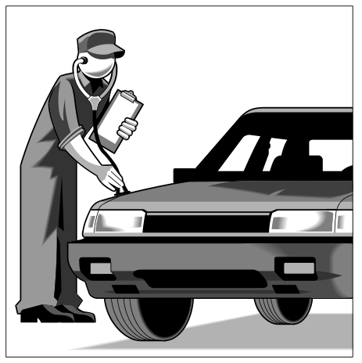
Program Maintenance
Solution within specifications?
Correct under all conditions?
Interface?
Logically and clearly written?
Well documented?
Efficient use of time and space?

Slide 10

Chapter 1 Fades Away

